Slide 1
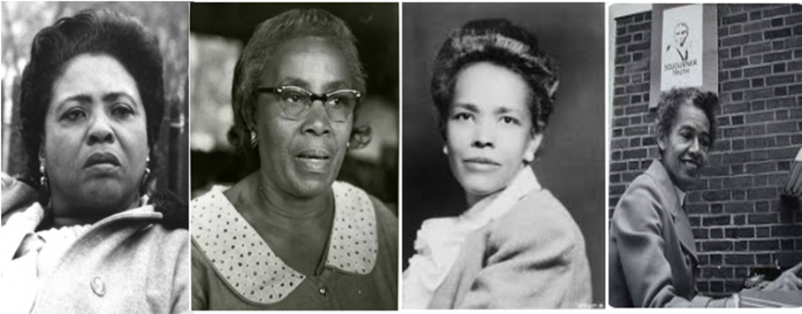
Unsung Heroines of the Civil Rights Movement
Clarafrancie d. Cromer Sowers
2023 Alabama civil Rights Pilgrimage presentation

Slide 2
Dedication
This presentation is dedicated to the women who sacrificed, organized and placed themselves in harms way during the Civil Rights Movement era, but their leadership often went unnoticed because they were women.

Slide 3
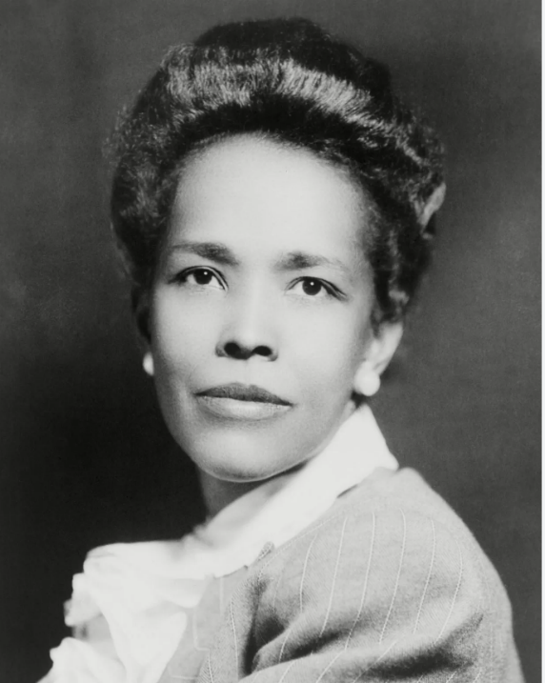
Ella Josephine Baker
December 13, 1903 – December 13, 1986
A Renaissance woman and Architect of the Civil Rights movement
National Director, Young Negroes’ Cooperative League (YNCL)
Publicity Director, National Negro Congress
Helped to establish the Southern Christian Leadership Conference (SCLC) & Student Nonviolence Coordinating Committee (SNCC)
Assistant Field Secretary, NAACP
Her life’s work permeated three principles: affirming human dignity, liberty to control one’s body, and organizing powerful weapons against injustices of black people.

Slide 4
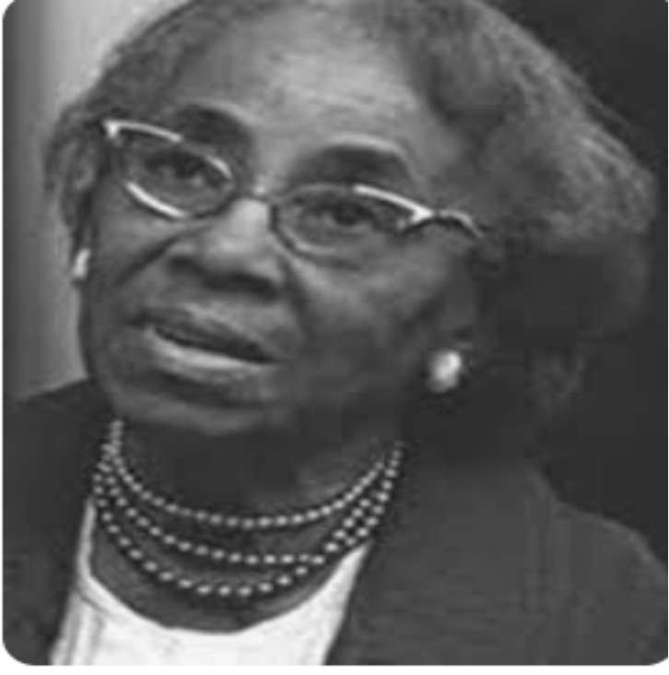
Septima Poinsette Clark
May 3, 1898 – December 15, 1987
Educator and Civil Rights activist
Taught adult literacy and voting rights classes for SCLC Voter’s Registration program
Advocated for pay equity for black and white teachers in South Carolina
Initiated the SCLC modeled Citizenship Education Program in South Carolina that spread throughout the South
Conducted workshops that help to launch the Montgomery bus boycott. Rosa Parks attended her class weeks before her arrest on December 1, 1955 in Montgomery, AL

Slide 5
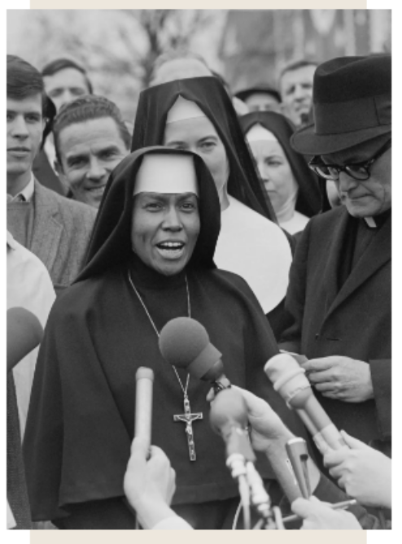
Sisters of St. Joseph of Carondelet
“Sisters of Selma”
Marched on Selma, Alabama in March 21,1965 supporting voting rights
Spoke on behalf of the silenced when many church leaders were complicit to address the treatment of blacks in America
6 sisters participated: 2 from St. Joseph of Carondelet, 2 from Franciscan Sisters of Mary, and 2 from Sisters of Loretto
Documentary: Sisters of Selma: Bearing Witness for Change by Avila University

Slide 6
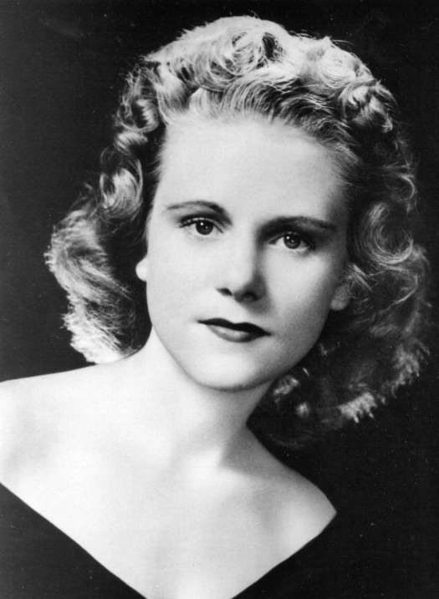
Viola Gregg Liuzzo
April 11, 1925 – March 25, 1965
Member of the Detroit, MI chapter of NAACP
Worked for the SCLC transportation services ferrying marchers between Selma and Montgomery
The only white women killed and murdered by KKK for her civil rights efforts in the aftermath of Bloody Sunday, Selma Voting Rights March, attempting to cross the Edmund Pettus Bridge in Selma, AL

Slide 7
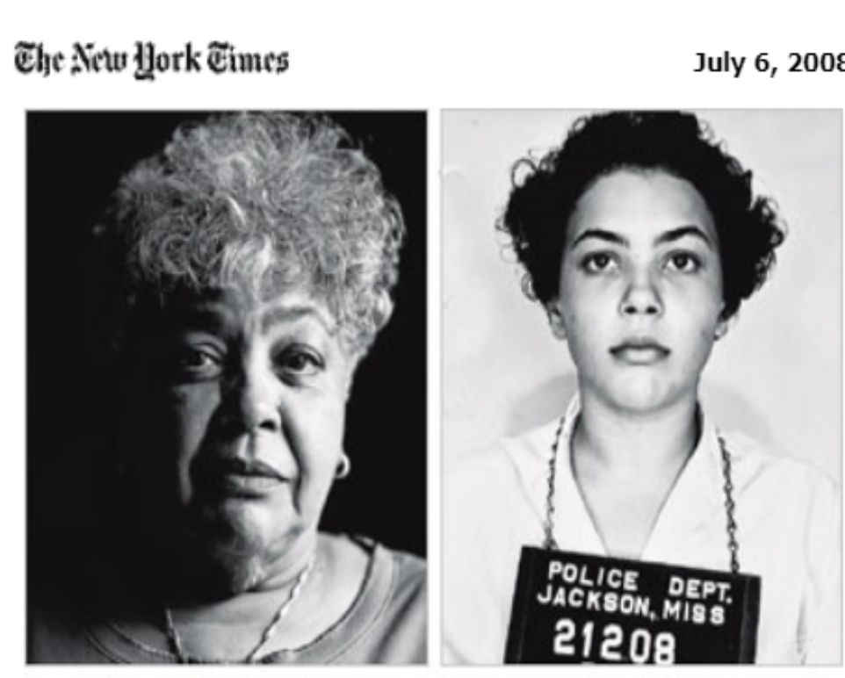
Helen O’Neal Gray
March 4, 1941 – February 24, 2010
In 1961, arrested and jailed as a Freedom Rider who attended Jackson State College
Taught SNCC’s Freedom School in McComb, MS
Co-chair with Charles Cox of the Jackson Non-Violent Movement
Assisted staff Lawyers Constitutional Defense Committee in Shreveport, LA
Professor of African American literature and composition at Wilberforce University
Notes:
"

Slide 8
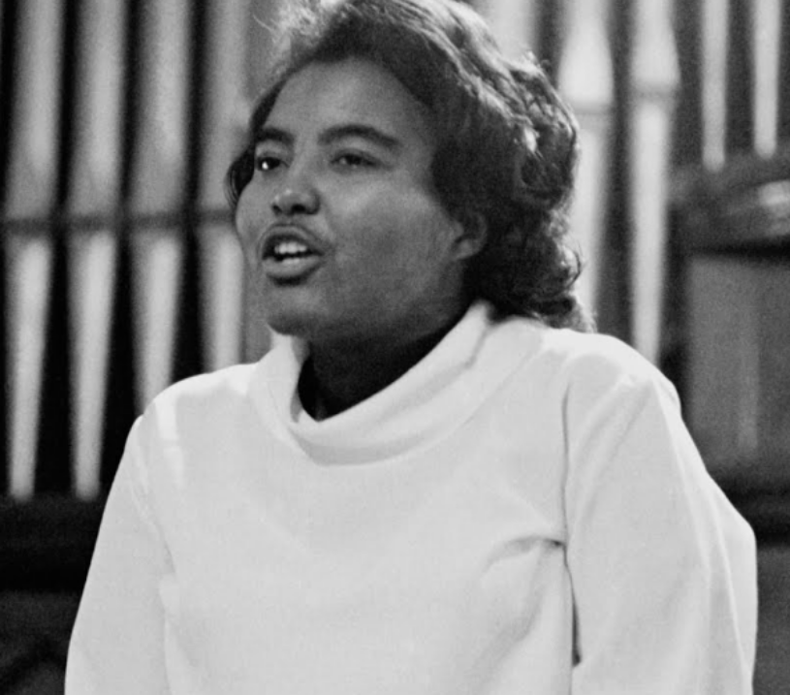
Rev. Dr. Prathia Hall
January 1, 1940 – August 12, 2002
SNCC Member in Terrell, GA helping with voter registration known as the Albany Movement
Praying at a church burning site, she expounded on the theme “I have a dream.” Dr. Martin Luther King remembered the Imagery and used it as his closing March on Washington speech.
Dedicated to social justice, she was responsible for training women in the ministry at Princeton Theological Seminary in New Jersey.

Slide 9
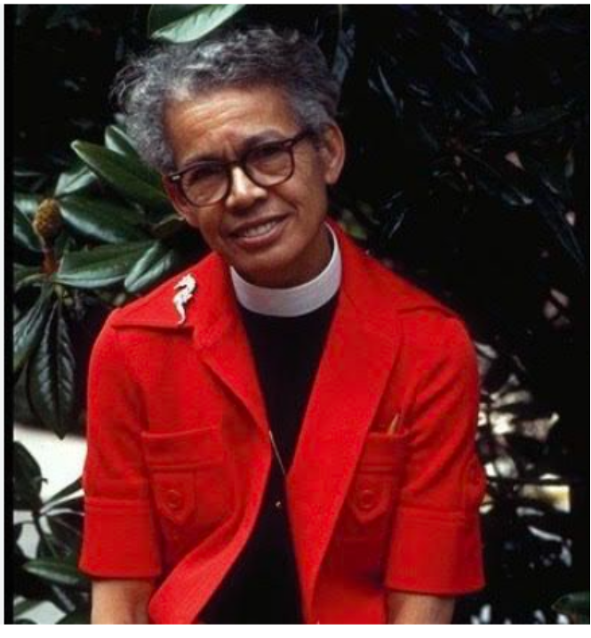
Rev. Dr. Pauli Murray
November 20, 1910 – July 1, 1985
Lawyer, Civil Rights activist for gender equality, author, and Episcopal priest
Denied entry into Harvard Law school to conduct post graduate work and obtain a LLM in 1944
Co-Founder of National Organization for Women (NOW)
Served Presidential Commission on the Status of Women appointed by President John F. Kennedy
1st African American women to be ordained priest in Episcopal Church

Slide 10
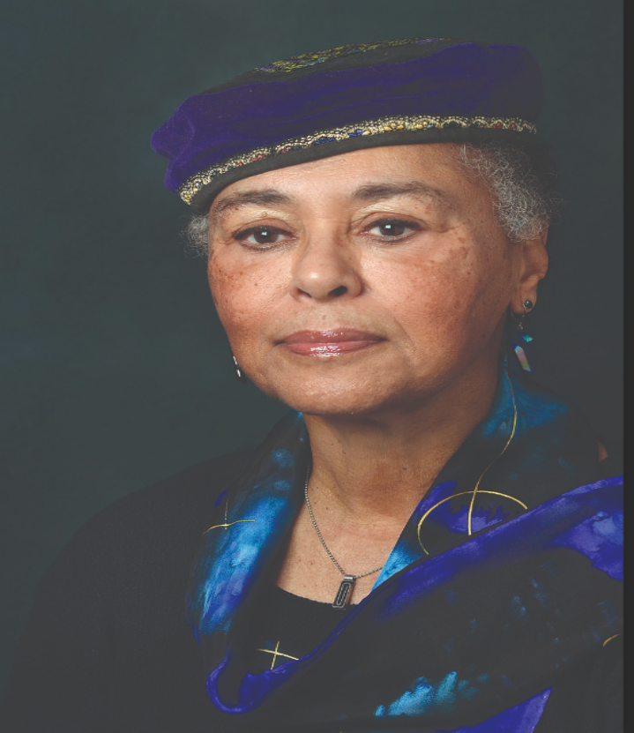
Judy Richardson
March 3, 1944 to Present
Joined Students for a Democratic Society (SDS) while a freshman at Swarthmore College
SNCC member in Mississippi and co-founded Drum and Spear bookstore in Washington, DC and filmmaker
Associate producer and education director for Eyes on the Prize, 14-hour PBS series on the Civil Rights Movement

Slide 11
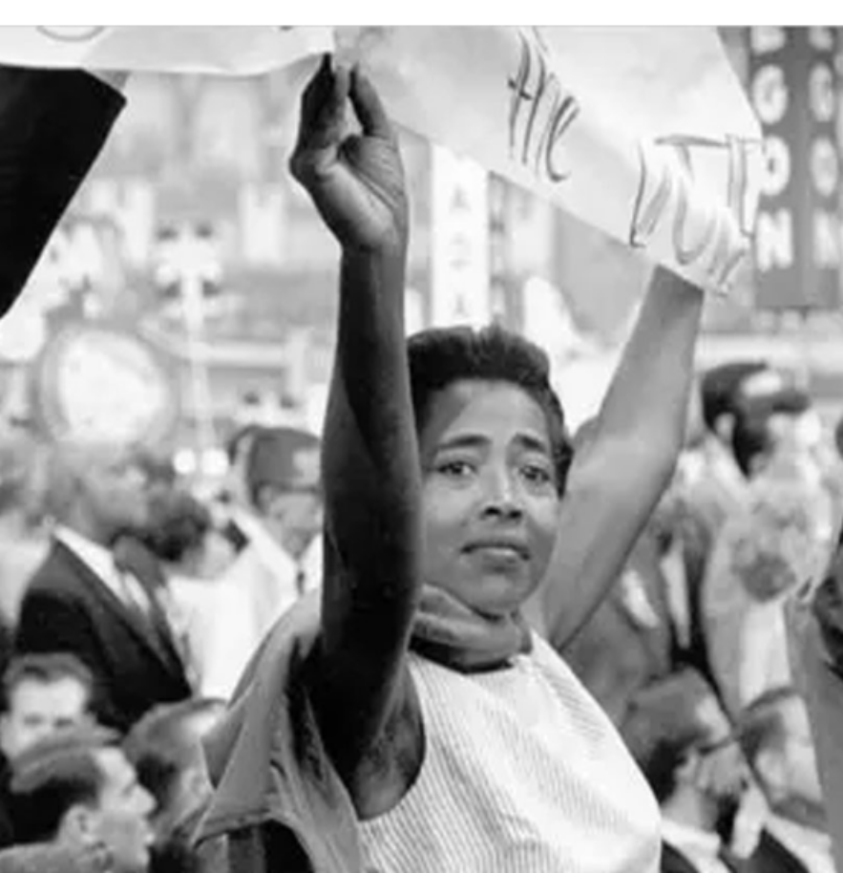
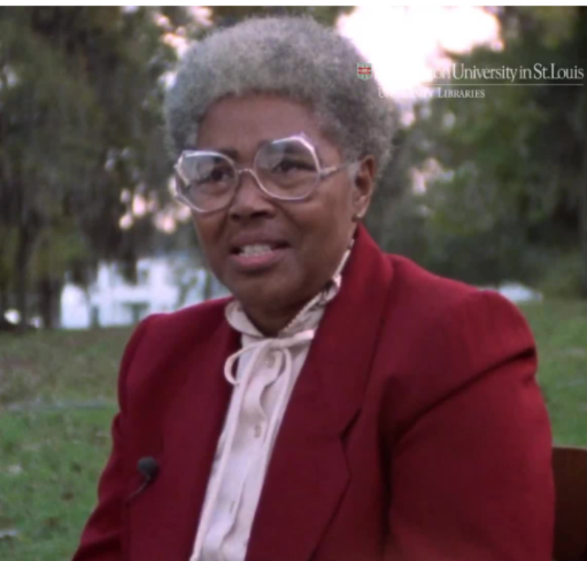
Victoria Jackson Gray Adams
November 5, 1926 – August 12, 2006
SNCC Voter’s Rights Advocate who provide refuge for young workers in Mississippi
Founder of Mississippi Freedom Democratic Party
  Planned to challenge and unseat all-white Mississippi delegates of the Democratic Party at National Convention in Atlantic, NJ in 1964
Ran for Senate in MS under MFDP ticket

Slide 12
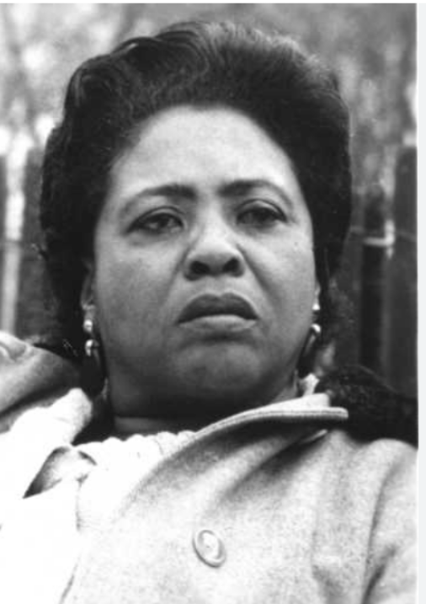
Fannie Lou Hamer
October 6, 1917 – March 14, 1977
Activist for voter’s rights in Mississippi
Helped to establish the Mississippi Freedom Democratic Party (MFDP)
In1964 before the Democratic Party’s Credentials Committee, she asked a rhetoric question, “Is this American?” citing racial injustice, how blacks suffered violent atrocities, and lynching in Mississippi.
Shot, jailed, and being severely beaten did not stop her from speaking the truth regarding separate and unequal political systems in her home state of Mississippi until her untimely death in 1977.

Slide 13
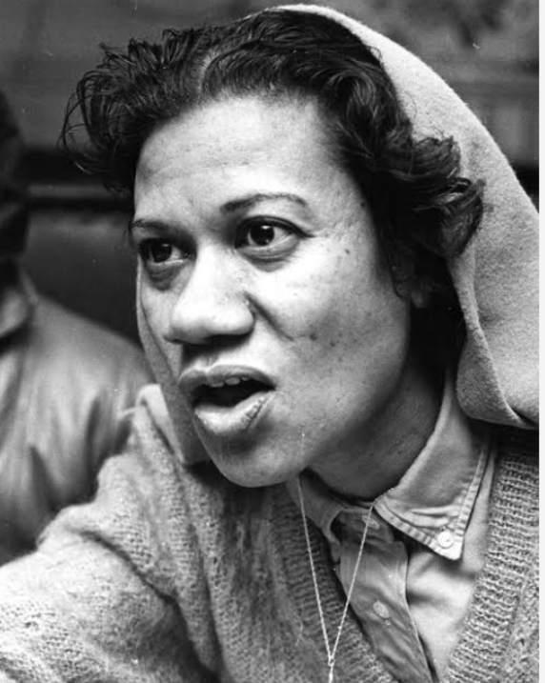
Gloria Richardson Dandridge
May 6, 1922 – July 15, 2021
Led grassroots Nonviolent Action Committee (CNAC) calling out racism and lingering segregationist practices in Cambridge MD
Changed city charter for public accommodations ordinances and abolishing redlining

Slide 14
Bibliography
Colburn, Carol. Sister of Selma: Bearing Witness for Change. 2020. https://www.avila.edu/avila-archives/sisters-of-selma/, (accessed October 12, 2023).
Faith S. Holseart, Martha Prescod, Norman Noonan, Judith Richardson, Betty Garman Robinson, Dorothy Zellner. Hands on the Freedom Plow: Personal Accounts by Women in SNCC. Chicago, IL: University of Illinois Press, 2010.
Gateway, SNCC Digital. SNCC Legacy Project and Duke University. Unknown. https://snccdigital.org/people/victoria-gray-adams/ (accessed October 1, 2023).
O'Neal-McCray, Helen. The History Makers (March 21, 2006).
Robnett, Belinda. How Long? How Long? African American Women in the Struggle for Civil Rights. New York City, NY: Oxford University Press, 1997.
Rosenberg, Rosalind. Jane Crow: The Life of Pauli Murray. New York City, NY: Oxford University Press, 2017.
Ross, Rosetta A. Witnessing & Testifying: Black Women, Religion, and Civil Rights. Minneapolis, MN: Fortress Press, 2003.
Stanton, Mary. From Selma to Sorrow: The Life and Death of Viola Liuzzo. Athens, GA: University of Georgia Press, 1998.
Vicki L. Crawford, Jacqueline Anne Rouse, and Barbara Woods. Women in the Civil Rights Movements: Trailblazers & Torchbearers 1941 – 1965. Bloomington, IN: Indiana University Press, 1990.
Walker, Alice. In Search of Our Mothers Gardens. New York City, NY: Harcourt Bruce Jovanovich, 1983.

